Slide 1
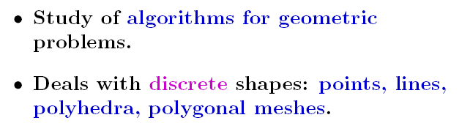
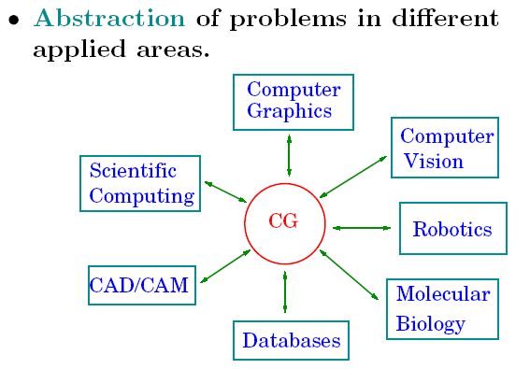
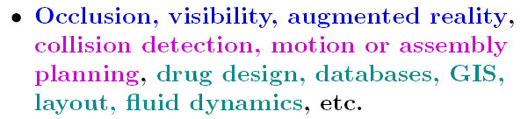
What does that mean?

Slide 2
Some basic algorithms
Given directed line segments p₀p₁ and p₀p₂,
determine whether p₀p₁ is clockwise from p₀p₂ with
respect to point p₀?
Given two line segments p₀p₁ and p₁p₂, if we
traverse p₀p₁ and then p₁p₂, do we make a left
turn at point p₁?
Do line segments p₀p₁ and p₂p₃ intersect?

Slide 3
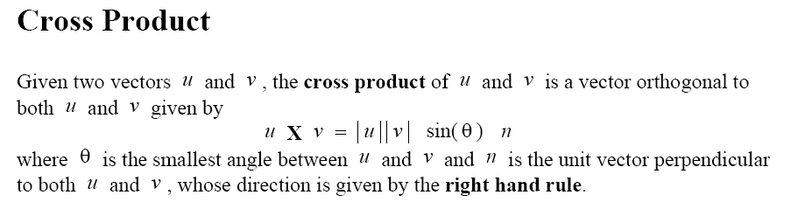
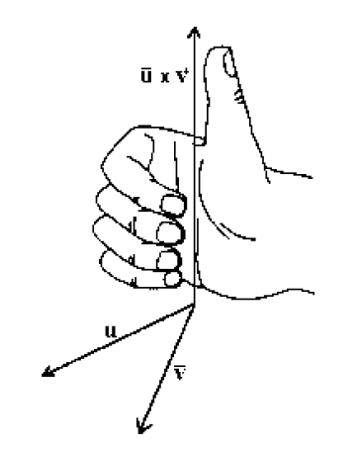
Cross Products
y
p₂ = (x₂,y₂)
p₁ = (x₁,y₁)
p₁ × p₂ = x₁y₂ – x₂y₁
= – p₂ × p₁
(0,0)
x
We assume that cross product is scalar given by this formula...

Slide 4
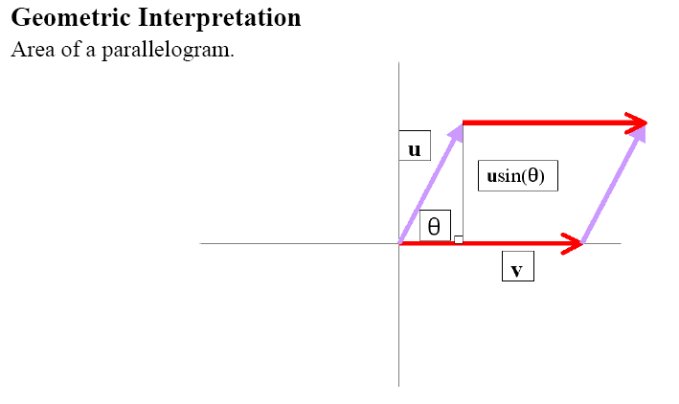
Cross Products
y
p₂ = (x₂,y₂)
p₁ + p₂
p₁ × p₂ = x₁y₂ – x₂y₁
= – p₂ × p₁
p₁ = (x₁,y₁)
(0,0)
x

Slide 5
Cross Products
y
+
The sign (+ or –) of cross
product depends in which
half plane (relative to p₁)
lies p₂
p₁
–
(0,0)
x

Slide 6
Some basic algorithms
Given directed line segments p₀p₁ and p₀p₂,
determine whether p₀p₁ is clockwise from p₀p₂ with
respect to point p₀?
Compute Π = p₁ × p₂
if Π > 0, then p₀p₁ is clockwise from p₀p₂
if Π < 0, then p₀p₁ is counterclockwise from p₀p₂
or,
if Π > 0, then p₀p₂ is counterclockwise from p₀p₁
if Π < 0, then p₀p₂ is clockwise from p₀p₁

Slide 7
Some basic algorithms
Given two line segments p₀p₁ and p₁p₂, if we
traverse p₀p₁ and then p₁p₂, do we make a left
turn at point p₁?
p₁
Compute Π = (p₂ – p₀) × (p₁ – p₀)
if Π > 0, then we make a right turn at p₁
if Π < 0, then we make a left turn at p₁
p₂
p₀

Slide 8
Two Segments Intersect?
One method: solve for the intersection point of the two lines containing the
two line segments, and then check whether this point lies on both segments.
In practice, the two input segments often do not intersect.
Stage 1: quick rejection if their bounding boxes do not intersect
if and only if
x < x ∨ x > x ∨ y < y ∨ y > y
4 1 3 2 4 1 3 2
L right of M? L left of M? L above M? L below M?
(x , y )
bounding boxes
4 4
(x , y )
2 2
M
Case 1: bounding boxes
do not intersect; neither
will the segments.
(x , y )
3 3
L
(x , y )
1 1

Slide 9
Bounding Box
Case 2: Bounding boxes intersect; the segments may or may
not intersect. Needs to be further checked in Stage 2.

Slide 10
Bounding Box - Stage 2
Two line segments do not intersect if and only if one segment
lies entirely to one side of the line containing the other segment.
p
1
p
3
( p − p ) × ( p − p ) and
( p − p ) × ( p − p ) are
both positive!
3 2 1 2
p
4 2 1 2
4
p
2

Slide 11
Necessary and Sufficient Condition
Two line segments intersect iff each of the two pairs of cross
products below have different signs (or one cross product in
the pair is 0).
(p − p ) × ( p − p ) and ( p − p ) × ( p − p )
(p − p ) × ( p − p ) and ( p − p ) × ( p − p )
// the line through p p
// intersects p p .
1 4 3 4 2 4 3 4
3
4
1
2
3 2 1 2 4 2 1 2
// the line through p p
// intersects p p .
1
2
3
4
p
p
3
p
p
1
1
3
p
4
p
4
p
p
2
2

Slide 12
Line Segment Intersection Algorithm
See page: 937

Slide 13
  Convex Non-convex
  Convex Polygon has every in degree less than 180
  Non Convex Polygon may have one or more in degrees greater than 180
Data is defined as points, lines, surfaces, polygons etc.

Slide 14
Convex Set
an object is convex if for every pair of points within the object, every point on the straight line segment that joins them is also within the object.

Slide 15
Problem: To determine whether a given point lies outside or inside a given polygon.
Answer: Yes if the point lies inside the polygon, No otherwise
Solution: Draw a line along the X –axis from the point in one direction i.e. the line can have a increasing as well as decreasing X – axis.
If the line thus drawn intersects ONLY once with any edge of the polygon then the point lies inside the polygon else it lies outside the polygon

Slide 16
Example:
_ _ _ _ _ _ _ _ _ __ _ _.P
The above point intersects only once with an edge of the polygon
hence it lies inside polygon

Slide 17
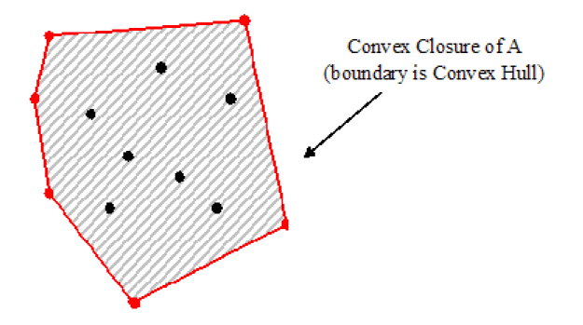
Convex Hull - Problem
Given n points on plane p₁, p₂, …,p_{n}, find the smallest
convex polygon that contains all points p₁, p₂, …,p_{n}.
[Adapted from G.Miller]

Slide 18
Convex Hull - Example
Given n line points on plane p₁, p₂, …,p_{n}, find the smallest
convex polygon that contains all points p₁, p₂, …,p_{n}.
p₁₀
p₆
p₉
p₁₂
p₇
p₅
p₄
p₃
p₁₁
p₈
p₁
p₂
p₀

Slide 19
Convex Hull - Example
Given n line points on plane p₁, p₂, …,p_{n}, find the smallest
convex polygon that contains all points p₁, p₂, …,p_{n}.
p₁₀
p₆
p₉
p₁₂
p₇
p₅
p₄
p₃
p₁₁
p₈
p₁
p₂
p₀

Slide 20
Graham Scan - Algorithm
procedure GrahamScan(set Q)
let p₀ be the point with the minimum y-coordinate
let <p₁, …, p_{m}> be the remaining points in Q, sorted by the
angle in counterclockwise order around p₀
Top(S) ← 0
Push(p₀, S); Push(p₁, S); Push(p₂, S)
for i ← 3 to m do
while the angle formed by points NextToTop(S), Top(S)
and p_{i} makes a non-left turn do
Pop(S)
Push(p_{i}, S)
return S

Slide 21
Graham Scan - Example
p₁₀
p₉
p₆
p₁₂
p₇
p₅
p₄
p₃
p₁₁
p₈
p₁
p₂
p₀

Slide 22
Graham Scan - Example
p₁₀
p₉
p₆
p₁₂
p₇
p₅
p₄
p₃
p₁₁
p₈
p₁
p₂
p₀

Slide 23
Graham Scan - Example
p₁₀
p₉
p₆
p₁₂
p₇
p₅
p₄
p₃
p₁₁
p₈
p₁
p₂
p₀

Slide 24
Graham Scan - Example
p₁₀
p₉
p₆
p₁₂
p₇
p₅
p₄
p₃
p₁₁
p₈
p₁
p₂
p₀

Slide 25
Graham Scan - Example
p₁₀
p₉
p₆
p₁₂
p₇
p₅
p₄
p₃
p₁₁
p₈
p₁
p₂
p₀

Slide 26
Graham Scan - Example
p₁₀
p₉
p₆
p₁₂
p₇
p₅
p₄
p₃
p₁₁
p₈
p₁
p₂
p₀

Slide 27
Graham Scan - Example
p₁₀
p₉
p₆
p₁₂
p₇
p₅
p₄
p₃
p₁₁
p₈
p₁
p₂
p₀

Slide 28
Graham Scan - Example
p₁₀
p₉
p₆
p₁₂
p₇
p₅
p₄
p₃
p₁₁
p₈
p₁
p₂
p₀

Slide 29
Graham Scan - Example
p₁₀
p₉
p₆
p₁₂
p₇
p₅
p₄
p₃
p₁₁
p₈
p₁
p₂
p₀

Slide 30
Graham Scan - Example
p₁₀
p₉
p₆
p₁₂
p₇
p₅
p₄
p₃
p₁₁
p₈
p₁
p₂
p₀

Slide 31
Graham Scan - Example
p₁₀
p₉
p₆
p₁₂
p₇
p₅
p₄
p₃
p₁₁
p₈
p₁
p₂
p₀

Slide 32
Graham Scan - Example
p₁₀
p₉
p₆
p₁₂
p₇
p₅
p₄
p₃
p₁₁
p₈
p₁
p₂
p₀

Slide 33
Graham Scan - Example
p₁₀
p₉
p₆
p₁₂
p₇
p₅
p₄
p₃
p₁₁
p₈
p₁
p₂
p₀

Slide 34
Graham Scan - Algorithm
procedure GrahamScan(set Q)
let p₀ be the point with the minimum y-coordinate
let <p₁, …, p_{m}> be the remaining points in Q, sorted by the
angle in counterclockwise order around p₀
Top(S) ← 0
Push(p₀, S); Push(p₁, S); Push(p₂, S)
for i ← 3 to m do
while the angle formed by points NextToTop(S), Top(S)
and p_{i} makes a non-left turn do
Pop(S)
Push(p_{i}, S)
return S

Slide 35
Graham Scan - Complexity
Sorting takes Θ(n log n) time
for loop executes Θ(n) times
each while loop might take up Θ(n) time
however, no more than Θ(n) for all while loops together
procedure GrahamScan(set Q)
let p₀ be the point with the minimum y-coordinate
let <p₁, …, p_{m}> be the remaining points in Q, sorted by the
angle in counterclockwise order around p₀
Top(S) ← 0
Push(p₀, S); Push(p₁, S); Push(p₂, S)
for i ← 3 to m do
while the angle formed by points NextToTop(S), Top(S)
and p_{i} makes a non-left turn do
Pop(S)
Push(p_{i}, S)
return S
T(n) = Θ(n log n) + const Θ(n) = Θ(n log n)

